Slide 1
Value Proposition

Slide 2
A value proposition refers to the value a company promises to deliver to customers should they choose to buy their product.
A value proposition is part of a company's overall marketing strategy.
The value proposition is a statement that introduces a company's brand to consumers by telling them what the company stands for, how it operates, and why it deserves their business.

Slide 3
A company's value proposition tells a customer the number one reason why a product or service is best suited for that particular customer.
A value proposition should be communicated to customers directly, either via the company's website or other marketing or advertising materials.
Value propositions can follow different formats, as long as they are "on brand," unique, and specific to the company in question.
A successful value proposition should be persuasive and help turn a prospect into a paying customer.

Slide 4
Outcome-Driven Innovation:
Outcome-Driven Innovation (ODI) is a strategy and innovation process that enables a company to create and market winning product and service offerings with a success rate that is 5-times the industry average.
ODI makes a company’s marketing efforts far more effective and its innovative. It begins with a deep understanding of the customer’s job-to-be-done (JTBD). (the way customers, markets and needs are defined, how markets are segmented and sized, and how ideas are constructed and tested).

Slide 5
IMPORTANCE
Discover hidden segments of opportunity in new markets.
Increase market share by better positioning current offerings along side the opportunities that exist in a market.
Improve existing offerings to get the customer’s job done better and/or more cheaply (grow revenue, reduce churn).
Strengthen the product portfolio with new product.
Align the organization through a common language and a shared understanding of customer needs.
Improve the customer experience.
Determine what new markets to enter.

Slide 6
Idea evaluation – What is it and how should one do it?
Friends evaluating new ideas is one of the most challenging parts for anyone. Because new ideas always have a lot of uncertainty involved and little data to back them up.
Thus, prioritizing ideas and making decisions on…. which ones to implement right away, which ones to test or pilot, which ones to keep for later, and which ones to outright discard, are often critical to decide.
Ideas related to existing business can, and should be, evaluated based on the rational metrics

Slide 7
These metrics can be either qualitative or quantitative, but for the purposes of simplifying the analysis, qualitative metrics are usually represented with quantitative estimates, for example on a scale of 1-5(1= strongly disagree and 5=strongly agree). These metrics can then be combined to form an overall numeric rating for the idea, which we refer to as the score.
But using metrics should not only be one criteria, one should simply test them out with real customers and/or users

Slide 8
Evaluation should be transparent
Regardless of the type of ideas being evaluated, you should always strive to make the evaluation of ideas transparent amongst those who are participating in the ideation.
This will lead to:
Improved communication
Organizational learning
Sense of fairness
Increased engagement

Slide 9
The idea can then be tested for feasibility / viability across several dimensions:
Technical feasibility—can the project be implemented as planned, using proven technologies, and without unreasonable technical risks?
Legal feasibility—are there any legal barriers to the project?
Environmental and social sustainability—at a minimum, does the project comply with national environmental and planning standards?

Slide 10
Economic viability: Many governments undertake some form of economic viability analysis (also known as socio-economic viability) to decide whether a proposed project/idea is a good use of public resources. A project is economically viable if the economic benefits of the project exceed its economic costs, when analyzed for society as a whole.

Slide 11
Business model validation
What do you do when your business model is based only on assumptions and educated guesses instead of solid facts?
How do you minimize the risk of failure when you intend to sell something new which has never been sold before?
How do you know that customers will buy it? These are ordinary issues for any innovative startup business model.

Slide 12
HOW TO VALIDATE YOUR BUSINESS MODEL
1. List all the assumptions
Finding the problem-solution-market fit is the most popular approach. Basically, it means that you must find and confirm a problem which is worth solving. Once you have a confirmation from potential customers that this particular problem is a real headache for them, you must create an acceptable solution. Once you have a general approval from customers that the solution is suitable for them, then you ask them to pay for it. If you get paid the price acceptable for you, congratulations! You have found the problem-solution-market fit.

Slide 13
HOW TO VALIDATE YOUR BUSINESS MODEL………
2. Create Minimum Viable Product
Don’t overload your MVP (Minimal Viable Product) with unnecessary features and details. Therefore, run planned experiments with MVPs as close to the real product as possible, yet make them easy and inexpensive to build. Selecting the right type of MVP depends upon the reason you are creating the MVP.
3. Find & engage potential customer.
4. Collect new insights and update business model.

Slide 14
Lean Management
Lean methodology is about continuously improving work processes, purposes, and people.
Lean management encourages shared responsibility and shared leadership.
This is why the two main pillars of the Lean methodology are:
Respect for people & Continuous improvements
The five principles are considered a recipe for improving workplace efficiency and include: 1) defining value, 2) mapping the value stream, 3) creating flow, 4) using a pull system, and 5) pursuing perfection.

Slide 15
Lean Canvas
When the Business Model Canvas was introduced, Ash Maurya redesigned it and created the Lean Canvas that is more actionable and entrepreneur-focused.
The Lean Canvas includes aspects for startups to deal with uncertainty and risk.

Slide 16
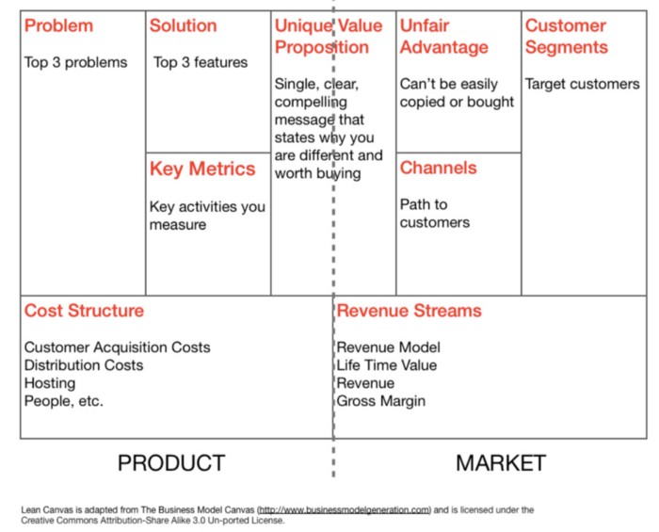

Slide 17
What Is a Business Model?
A business model is an outline of how a company plans to make money with its product and customer base in a specific market. At its core, a business model explains four things:
What product or service a company will sell
How it intends to market that product or service
What kind of expenses it will face
How it expects to turn a profit

Slide 18
B2B Business Model?
Let’s start with what B2B business models are. It is a conceptual structure that supports a company and explains how it is functioning, and making a profit.
It mainly refers to transactions or business activities between two companies. It involves one company selling products or providing services to another company. In simpler language, a company is another company’s consumer. Various types of B2B business models work in several sectors such as research and development, webpage designing services, call centers, human resource and recruitment, marketing and advertising, etc.

Slide 19
Business-to-Consumer (B2C)?
The term business-to-consumer (B2C) refers to the process of selling products and services directly between a business and consumers who are the end-users of its products or services. Most companies that sell directly to consumers can be referred to as B2C companies.

Slide 20
Forms of Business Ownership Structures

Slide 21

FORMS OF ENTITIES
Proprietorship
More than one person required
Suitable for small business
Unlimited Liability of Partners
Partnership
More than one person required
Registration Under LLP Act , 2008
Suitable for professionals
Limited liability of partners
Limited Liability Partnership
Registration not required
Single Owner
Small Investment required
Suitable for small business
Unlimited Liability of the owner
Private Limited Company
Minimum two individuals required
Registration Under Companies Act, 2013
Limited Liability of owners
Suitable for Large business

Slide 22
What is a Liability?
Legal responsibility /obligation towards something.
What is Unlimited Liability ? Indefinite extent of liability to pay off firm’s debts and obligations.
Example: in case of payments to creditors, personal assets of the owners can be utilised.
Thus, owner’s personal assets are at risk.
What is Limited Liability? Person’s liability is limited to a fixed sum.
(Personal assets of the owner are safe)
Que: What is Proprietorship?
It is a type of business form which is owned and run
by a SINGLE PERSON and there is NO LEGAL DIFFERENCE between owner and the business .
Que: Any registration required for Proprietorship?
No formal registration is required under any law, however, registration is required with sales tax deptt. or service tax deptt. whichever is applicable.
Que: What are the benefits?
It can be formed easily
Single control
Single Decision making
No extra cost for running business
Que: What are the limitations of Sole proprietorship ?
The liability (obligation ) of the owner will be Unlimited
Not suitable for large business
Low access to investment in the business from outsiders

Slide 23
Que: What is Partnership ?
Association of TWO or more persons
Sharing of profits & losses
Business may be carried on by all or anyone of them acting for all.
Max Partners Twenty (20)
Ten (10) in case of banking business
Min Partners Two (2)
Easy to set up business.
Low costs of formation
No formal Compliance under Partnership Act .
Audit required only under Income Tax Act, 1961.
Dissolution is easy.
Que: What are the benefits of Partnership?
COMPLIANCE
To follow the rules, laws, legal
regulations etc.
DISSOLUTION
Ceasing to carry on the business and closing the firm
Quick way to commence
PARTNERSHIP DEED
It is a documents in which terms of partnership (rights, obligation, duties, profit & loss sharing etc.), are written and agreed by the partners.
It is the principal document of any partnership firm. However, it is not compulsory to get the deed registered.
Que: What are the limitations of Partnership?
Liability is unlimited (explained in previous slide)
Not a saleable form of business organization
Cannot file a suit against anybody (unless registered)
Each partner is an agent for the partnership business: decisions made by any partner bind all the partners

Slide 24
Que: What is Limited Liability Partnership ?
Hybrid version of private limited company and a partnership firm
Organized form of Partnership firm with Limited Liability.
LLP
Private Limited Company
Que: What are the benefits of LLP ?
Partnership
Low cost of formation.
Easy to establish, manage & run
Less Compliance
No Audit requirement: upto Capital contribution of
Rs. 25 lakh or turnover of Rs. 40 lakh.
CAPITAL
Amount invested for starting a business.
It can be in the form of money, assets or any other form.
Que: What are the limitations of LLP ?
LLP AGREEMENT
It is same as Partnership Deed.
(already explained in previous slide)
Any act of the partner without the consent of the other partner binds the LLP.
Liability extend to personal assets under some cases
e.g. fraud case.
Cannot raise money from outsiders without diluting control.
Min Partners Two (2)
Max Partners No limit

Slide 25
Que: What is Private (Pvt) Limited Company ?
Registered business form in which owners liability is limited
At least 2 persons are required to form a Company
It is registered with Registrar of Companies (ROC)
Que: What are the benefits of a Pvt. Limited Company ?
Separate legal existence of the Company
Limited liability (explained in the previous slides)
Suitable for comparatively larger business
WHAT IS A SHARE/SHARE CAPITAL? The capital of the company is divided into small units. The units are called Shares. The capital can be divided into any number of shares of fixed amount. Example: Capital of a company is Rs. 1,00,000 Value of one share is Rs. 10. Therefore, number of shares will be 10,000
AUTHORISED |  | PAID-UP
CAPITAL |  | CAPITAL
Maximum amount of |  | It is the amount paid
capital that company |  | by the shareholder
can raise by issue of |  | against the shares
shares. |  | issued.
Memorandum of Association (MOA): is a principal document of a Company. It states the name, objectives, Authorised share capital etc. A Company cannot do anything which is not written in MOA
Article of Association(AOA): contains the purpose of the company as well as the duties and responsibility of the members and directors.
Que: What are the limitations of a Pvt. Limited Company ?
Shares cannot be sold or transferred to anyone without the agreement of other shareholders
Not allowed to invite public to subscribe its shares.

Slide 26
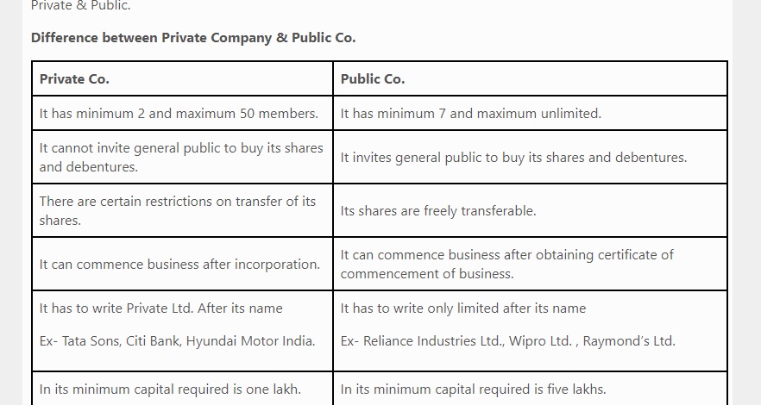

Slide 27
COMPARISON OF ENTITIES

Slide 28
COMPARISON OF ENTITIES
S. No | Basis | Partnership | LLP | Ltd. Company
1 | Governing Law | Indian Partnership Act, 1932 | Limited Liability Partnership Act, 2008 | Companies Act, 2013
2 | Liability | Unlimited | Limited Liability | Limited Liability
3 | Registration | Optional | Mandatory | Mandatory
4 | Legal Proceeding | Only Registered Partnership can sue third party. | Can sue and be sued | Can sue and be sued.
5 | Charter Document | Partnership Deed | LLP Agreement | MOA and AOA
6 | Members | Min.-2 Max- 20 (Max: 10, in case of Banking Business) | Min -2 Max. - no limitation | Min.-2 members required

Slide 29
COMPARISON OF ENTITIES
S. No | Basis | Partnership | LLP | Company
7 | Foreign Participation | Can not form partnership firm in India | Can be a Partner | Can be a member
8 | Audit of Accounts | Required as per income tax act when turnover exceed 1 Crore. | LLP having turnover above Rs. 40 Lakhs or contribution Rs. 25 Lakhs requires audit | Companies are required to get their accounts audited annually
9 | Transfer/ In heritance Of Rights | Not Transferable. | Regulation are governed by LLP Agreement | Ownership is transferable
10 | Voting Rights | As per Partnership agreement/deed. | As per the terms of LLP Agreement | As per AOA and the Companies Act, 2013

Slide 30
Hindu Undivided Family (HUF) : Business Formed by birth in a Hindu family
The family pool of resources
Family members are automatic co-owners
Head of the family (Karta) is the decision maker
The Karta has unlimited liability.

Slide 31
Co-operative Society
A co-operative society is a voluntary association of persons of moderate means who unite together to protect & promote their common economic interests.
FEATURES
1.Voluntary association: Every one having a common interest is free to join a co-operative society and can also leave the society after giving proper notice.
2. Limited liability: The liability of the member is limited to the extent of their capital contribution in the society.
3. Democratic control: Management & Control lies with the managing committee elected by the members by giving vote. Every member has one vote irrespective of the number of shares held by him.

Slide 32
4. Bound by govt.’s rules: They have to be tide by the rules and regulations framed by govt. for them.
5. Distribution of surplus: The profit is distributed on the basis of volume of business transacted by a member and not on the basis of capital contribution of members.
TYPES OF CO-OPERATIVE SOCIETIES
1. Consumers co-operative Society – It formed to protect the interest of consumers.It seeks to eliminate middleman by establishing a direct link with the producers.
2. Producer’s Co-operative Society – The main aim is to help small producers who cannot easily collect various items of production and face some problem in marketing.

Slide 33
3. Marketing Co-operative Society – It performs various marketing function such as transportation, warehousing, packing, grading, marketing research etc. for the benefit of its members.
4. Farmer’s Co-operative Society – In such societies, small farmers join together and pool their resources for cultivating their land collectively. Such societies provide better quality seeds, fertilizers, machinery and other modern techniques for use in the cultivation of crops. It provides them opportunity of cultivation on large scale.

Slide 34
5. Credit co-operative Society – Such societies protect the members from exploitation by money lenders. They provide loans to their members at easy terms and reasonably low rate of interest.
6. Co-operative Housing Society – The main aim is to provide houses to people with limited means/income at reasonable price.

Slide 35
Introduction to risk
While risk has always been part of financial activity, the 1990's saw risk management become a key business function within banks and other financial institutions.
Risk Management
Risk Management is primarily concerned with reducing the potential of any internal or external events to detrimentally affect a business. It should be a set of continuous and developing processes that are applied throughout an organisation's strategy and should methodically address all the risks surrounding past, present and future activities.

Slide 36
Risk Management objectives
There are two main areas of focus for Risk Management, each with its own set of objectives:
Internal
To reassure management that the business is aware of, and in control of, current and future business risks
To safeguard business assets and reputation
To help improve the business's operating performance and shareholder value
To improve efficiency by reducing risk exposure inherent in the business processes
To support the achievement of strategic goals
External
To ensure compliance with regulatory requirements
To deliver competitive advantage
To reassure stakeholders and interest groups that the business is actively managing risk

Slide 37
Opportunity Sizing
Opportunity Sizing helps entrepreneurs to figure out a product roadmap. It is the act of giving a numeric value or range of values to the potential impact of some course of action:
“If we build feature X, we will make $ZZ & $MM more dollars in yearly revenue”.
“If we can lower the cost of this drug by $XX, we will save ZZ million lives.”
“If we can switch to electric vehicles, we will prevent ZZ million tons in carbon emissions”.

Slide 38
Revenue Stream?
“A revenue stream is a source of revenue of a company or organization.”
Why Are Revenue Streams Important?
Without understanding the specific way(s) you are going to sell your widget, it’s going to be tough to market it.
1. Selling Assets (Asset Sale)
This is the most widely utilized in mainstream business. You sell something, and your customer buys it and can do with it what they please (use it, resell it, and even destroy it).
An Asset Sale also happens when someone sells their company, or forms a new one with another organization.

Slide 39
2. Fees for Usage (Usage Fees)
The Usage Fees revenue stream is when a company makes money by how often someone uses their service.
For example, a cell phone company will (generally) charge you based on how much data you use, how many phones are on your plan, etc.
3. Subscription Fees
This is the revenue stream that is generated by someone purchasing ongoing access to your product or service.
Good examples of this model are Netflix

Slide 40
4. Renting, Leasing & Lending
This revenue stream is built by the temporary use of an asset by a customer for a fixed period of time.
5. Licensing to 3rd Parties
This is when the owner of the content keeps the copyright, but allows third parties to use their content for a fee.

Slide 41
Financing Entrepreneurial Business
Sources of Financing for small business or startup can be divided into two parts: Equity Financing and Debt Financing.
Personal Investment or Personal Savings
Venture Capital
Business Angels
Assistant of Government
Commercial Bank Loans and Overdraft

Slide 42
8 Major Sources of Industrial Finance Available in India
1. Internal Self-Finance: The saving of the unit itself. It may be the household, the business or the government. An advantage of investment through internally generated funds is that it combines the acts of saving and investment.

Slide 43
2. Equity, Debentures and Bonds:
A large part of finance for fixed investments [building, machines, etc.] comes from different types of equity or shares such as ordinary, cumulative and non-cumulative preference shares. These are debt (loans), instruments. The buyers of those debentures and bonds are the creditors of companies. They get a fixed rate of interest on the money invested in these securities.
3. Public Deposits: Another source is public deposits. It is also a debt-instrument, mostly for short-term finance. Under this system, people keep their money as deposit with these companies or managing authorities for a period of six months, a year, two years, three years or so. Depositors receive a fixed interest.

Slide 44
4. Loans from Banks: Commercial banks can do also provide funds for meeting short-term needs or for working capital. Loans are given against the guarantee of government securities and stocks with companies.
5. The Managing Agency System: Under this system an individual or a group of individuals finance the initial stage of the establishment of industries, and manage many activities of the company thus established very often.
6. Indigenous Bankers: Inspite of the establishment of new financial institutions, indigenous bankers also advance financial help to a few large-scale industries, particularly during the time of stress, both for fixed capital and working capital. But mainly they have provided finance to small scale industries.

Slide 45
7. Development Finance Institutions: Established with the help of the Government to fill-in the gap in industrial finance and to promote the objective of planning, these institutions cater to the needs of large and small industries. DFIs These institutions provide huge quantity of finances for setting up of new industries, for meeting their several needs and in several forms. These also ensure and monitor the use of finance in pre- planned directions. As such these fit well with the modem scenario of industrial development.
8. Foreign Capital: As a supplement to domestic finance, external capital too has been made use of in meeting the needs of industrial finance, mostly for long-term needs. This has taken several forms. There is the foreign aid (i.e., loans on concessional term) from foreign governments and foreign institutions (like the World Bank) extended to the Government. A part of this assistance has also gone to the private sector

Slide 46
Seed capital Seed capital is the funding required to get a new business started. This initial funding, which usually comes from the business owner(s) and perhaps friends and family, supports preliminary activities such as market research, product research and development (R&D) and business plan development.
Seed capital funding is considered high-risk because the business is not fully functional and has no track record. Investors who provide seed capital funding often do so for a stake in the company. Once a startup has demonstrated feasibility, it is more likely to attract venture capital or angel investment to provide the greater funds necessary to get the business up and running.

Slide 47
Seed Capital vs. Venture Capital
Although seed capital and venture capital are often used as synonyms, they tend to overlap. Seed capital is generally used to develop a business idea to the point that it can be presented effectively to venture capital firms that have large amounts of money to invest. If venture capital firms like the idea, they generally get a stake in the new venture in return for investing in its development.
Venture capitalists provide the lion's share of the money needed to start a new business. It is a considerable investment, paying for product development, market research, and prototype production. Most startups at this stage have offices, staff, and consultants, even though they may have no actual product.

Slide 48
Critical Path Method (CPM)
After preparing the network diagram and indicating the time for each activity, we can identify the various possible paths.
The various terms related to CPM are defined below:
Path:It refers to unbroken or continuous chain of activities from the start event to end event in the network diagram.
Critical path: It is the path which takes longest duration. It is represented by double or thick arrow line to distinguish it from the other non-critical paths.
Critical activities: These are activities lying in the critical path and its delay in start will cause a further delay in the completion of the entire project.
Preceding activities: Activities that must be completed immediately prior to the start of another activity are called predecessor activities.

Slide 49
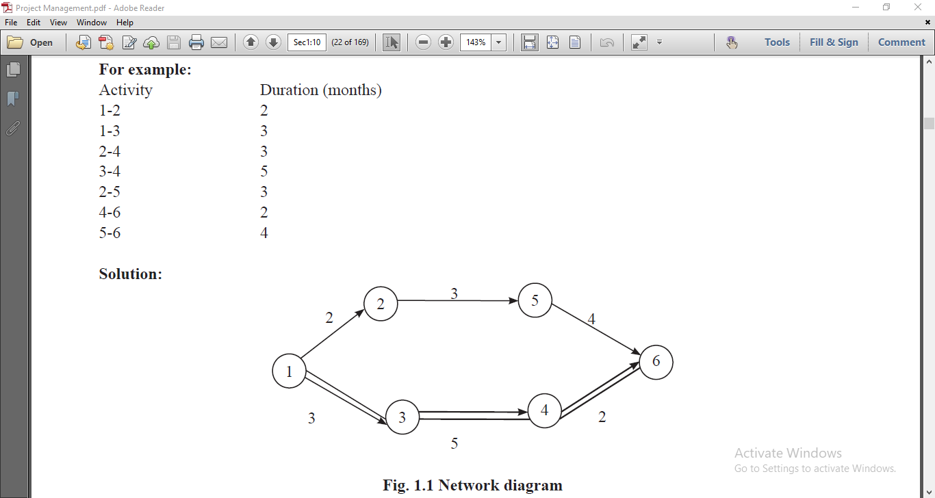

Slide 50
The following are the advantages of CPM
It makes better and detailed planning possible.
It helps in ascertaining the time schedule.
Control by management becomes easy.
It identifies most critical elements and thus more attention can be paid on these activities.
It facilitates optimum utilisation of resources.

Slide 51
Program Evaluation and Review Technique (PERT) is a method used to examine the tasked that are in a schedule and determine a variation of the Critical Path Method (CPM). It analyzes the time required to complete each task and its associated dependencies to determine the minimum time to complete a project.

Slide 52
Steps in PERT
The following steps are used in PERT:
Activities are arranged in a logical sequence.
Network diagram is drawn and events are numbered.
Using 3 time estimates, the expected time for each activity is calculated.
The total project duration is worked out.
Standard deviation and variance for each activity are found.

Slide 53
Generally 3 time estimates that are used are:
Optimistic time (to): It is the shortest possible time in which an activity can be completed. The probability of happening this is 1 in 100.
Pessimistic time (tp): It is the maximum possible time in which an activity can be completed, if everything goes wrong. The happening this also might be 1 in 100.
Most Likely time (tm): This lies in between ‘to’ and ‘tp’. It is the best estimated time in the normal conditions that an activity would require.
The expected time of each activity would be calculated by the following formula:
te = to +4tm +tp /6

Slide 54
PERT is Probabilistic
It used for the projects where time requirement is not known
Used in R & D projects
PERT analysis doesn’t consider Cost
Was developed in 1950 by US Navy
CPM is Deterministic
Used for those projects which are repetitive in nature
Used in plant maintenance & in construction work
CPM deals with cost of project schedule and there minimization
Developed in1975 by DU Pont.

Slide 55
Initiatives by Government of India
Make in India (launched in September 2014 )
Stand Up India ( Bank loan from 10 lakh to 1 Crore) helps sc, st, womes majorly
Start-up India (January 2016)
AIM (Atal Innovation Mission- in 2015) its primary objectives to provide world class innovation hubs, startup business and other self-employment activity.
STEP (Support to training and Employment Programme)
NSDM(National Skill Development Mission-July 2015) Its aims to build synergies across sectors and states in skilled industry and initiatives and to enable decision making without compromising quality of products.

Slide 56
The term 'marketing mix' is a foundation model for businesses, historically centered around product, price, place, and promotion (also known as the "4 Ps"). The marketing mix has been defined as the "set of marketing tools that the firm uses to pursue its marketing objectives in the target market". Thus the marketing mix refers to four broad levels of marketing decision: product, price, place, and promotion.

Slide 57
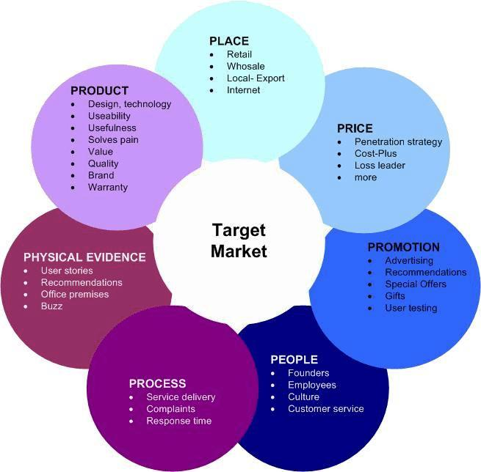

Slide 58
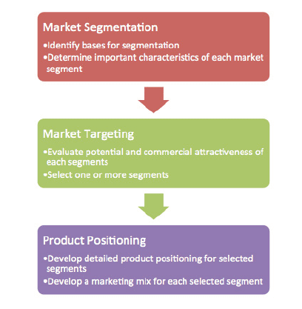

Slide 59


Slide 60
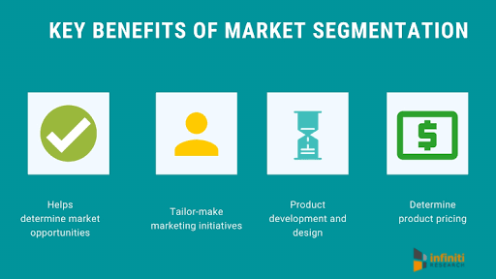

Slide 61
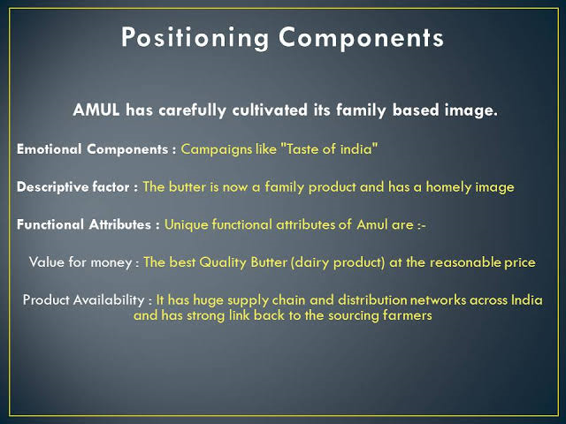

Slide 62
Sales Planning is a key function in the procedure of sales management process. Sales planning is an effective method that involves sales forecasting, demand management, setting profit-based sales targets, and the written execution steps of a sales plan. Sales Planning involves two steps, i.e. formation and maintenance of a particular plan, in which a salesperson is expected to use his conceptual skills to meet his objective.

Slide 63
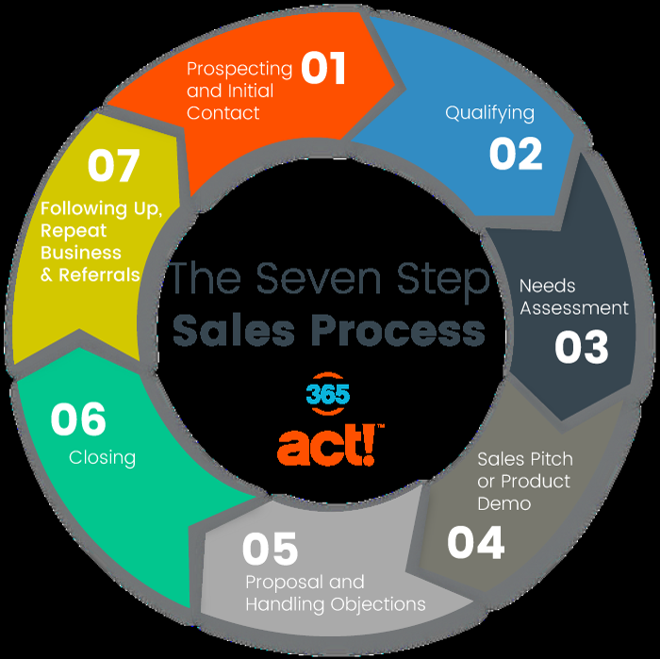

Slide 64
Team building is a management technique used for improving the efficiency and performance of the workgroups through various activities.
Team building is the process of turning a group of individual contributing employees into a cohesive team—a group of people organized to work together to meet the needs of their customers by accomplishing their purpose and goals.
Team building can include the daily interaction that employees engage in when working together to carry out the requirements of their jobs.
Team building can also involve structured activities and exercises led by team members.

Slide 65
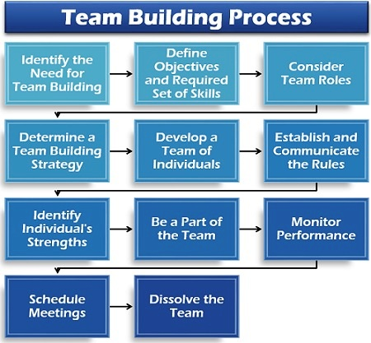

Slide 66
BLUE OCEAN STRATEGY?
Blue ocean strategy is the simultaneous pursuit of differentiation and low cost to open up a new market space and create new demand. It is about creating and capturing uncontested market space, thereby making the competition irrelevant. It is based on the view that market boundaries and industry structure are not a given and can be reconstructed by the actions and beliefs of industry players.

Slide 67
BLUE OCEAN STRATEGY VS RED OCEAN STRATEGY
Blue ocean
Create uncontested market space
Make the competition irrelevant
Create ad capture new demand
Red Ocean
Compete in existing market
Beat the competition
Exploit existing demand

Slide 68
Innovation can be a confusing topic because there are so many different kinds of innovations out there and everyone seems to use the term differently.
Most innovations are smaller, gradual improvements on existing products, processes and services while some innovations can be those ground-breaking technological inventions or business models that transform industries
Innovation Matrix
One way to categorize innovation is to classify it based on two dimensions: the technology it uses and the market it operates in. We can use the innovation matrix to visualize the most common types of innovation:

Slide 69
